Slide 1


Returning to the Moon: NASA Artemis Missions
Hafiz Muhammad Hamza
Shoaib Akhtar
Adal Imtaiz
www.nasa.gov

Slide 2

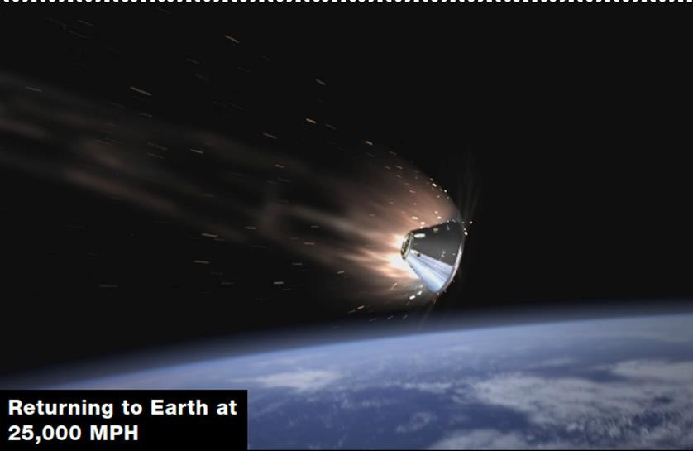
INTRODUCTION
Moon Return and Milestones
  Artemis aims to land the first woman and next man on the Moon, marking a historic exploration milestone.
Sustainable Lunar Presence
  The program focuses on establishing a sustainable human presence on the Moon for future exploration missions.
Technology and Partnerships
  Artemis leverages advanced technology, international partnerships, and commercial collaborations to achieve its goals.
Inclusivity and Inspiration
  The program emphasizes diversity and aims to inspire future generations through innovation in space exploration.

Slide 3
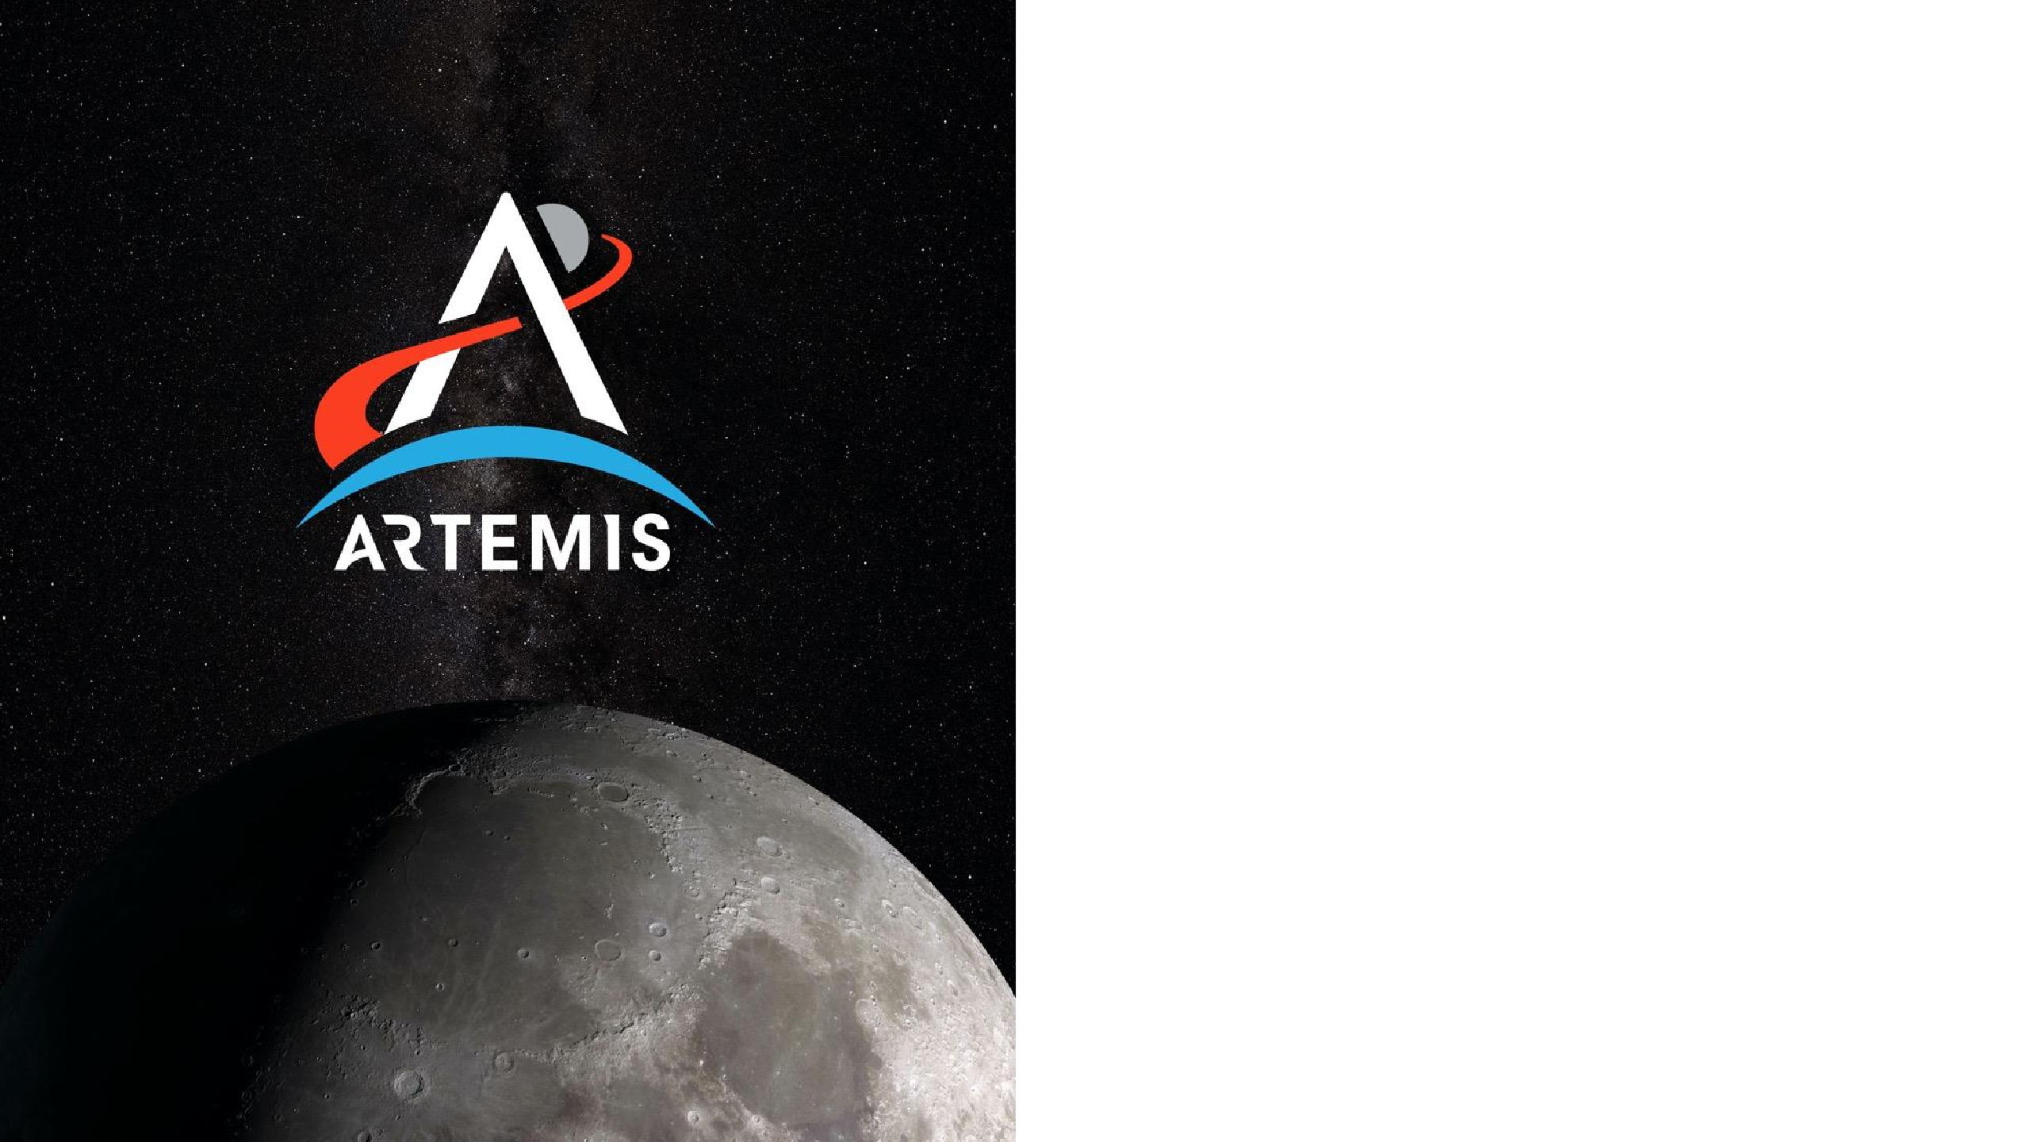

Twin sister of Apollo and goddess of the Moon in Greek mythology, Artemis is the torch-bringer personifying our path to the Moon. During the next era of human exploration, we will discover life-saving, Earth-changing science and technology along the way.
NASA’s goal is to land the first woman and first person of color on the Moon and return them safely to Earth. When the Artemis astronauts land on the lunar surface, they will step into the future, bringing all of humanity with them.

Slide 4
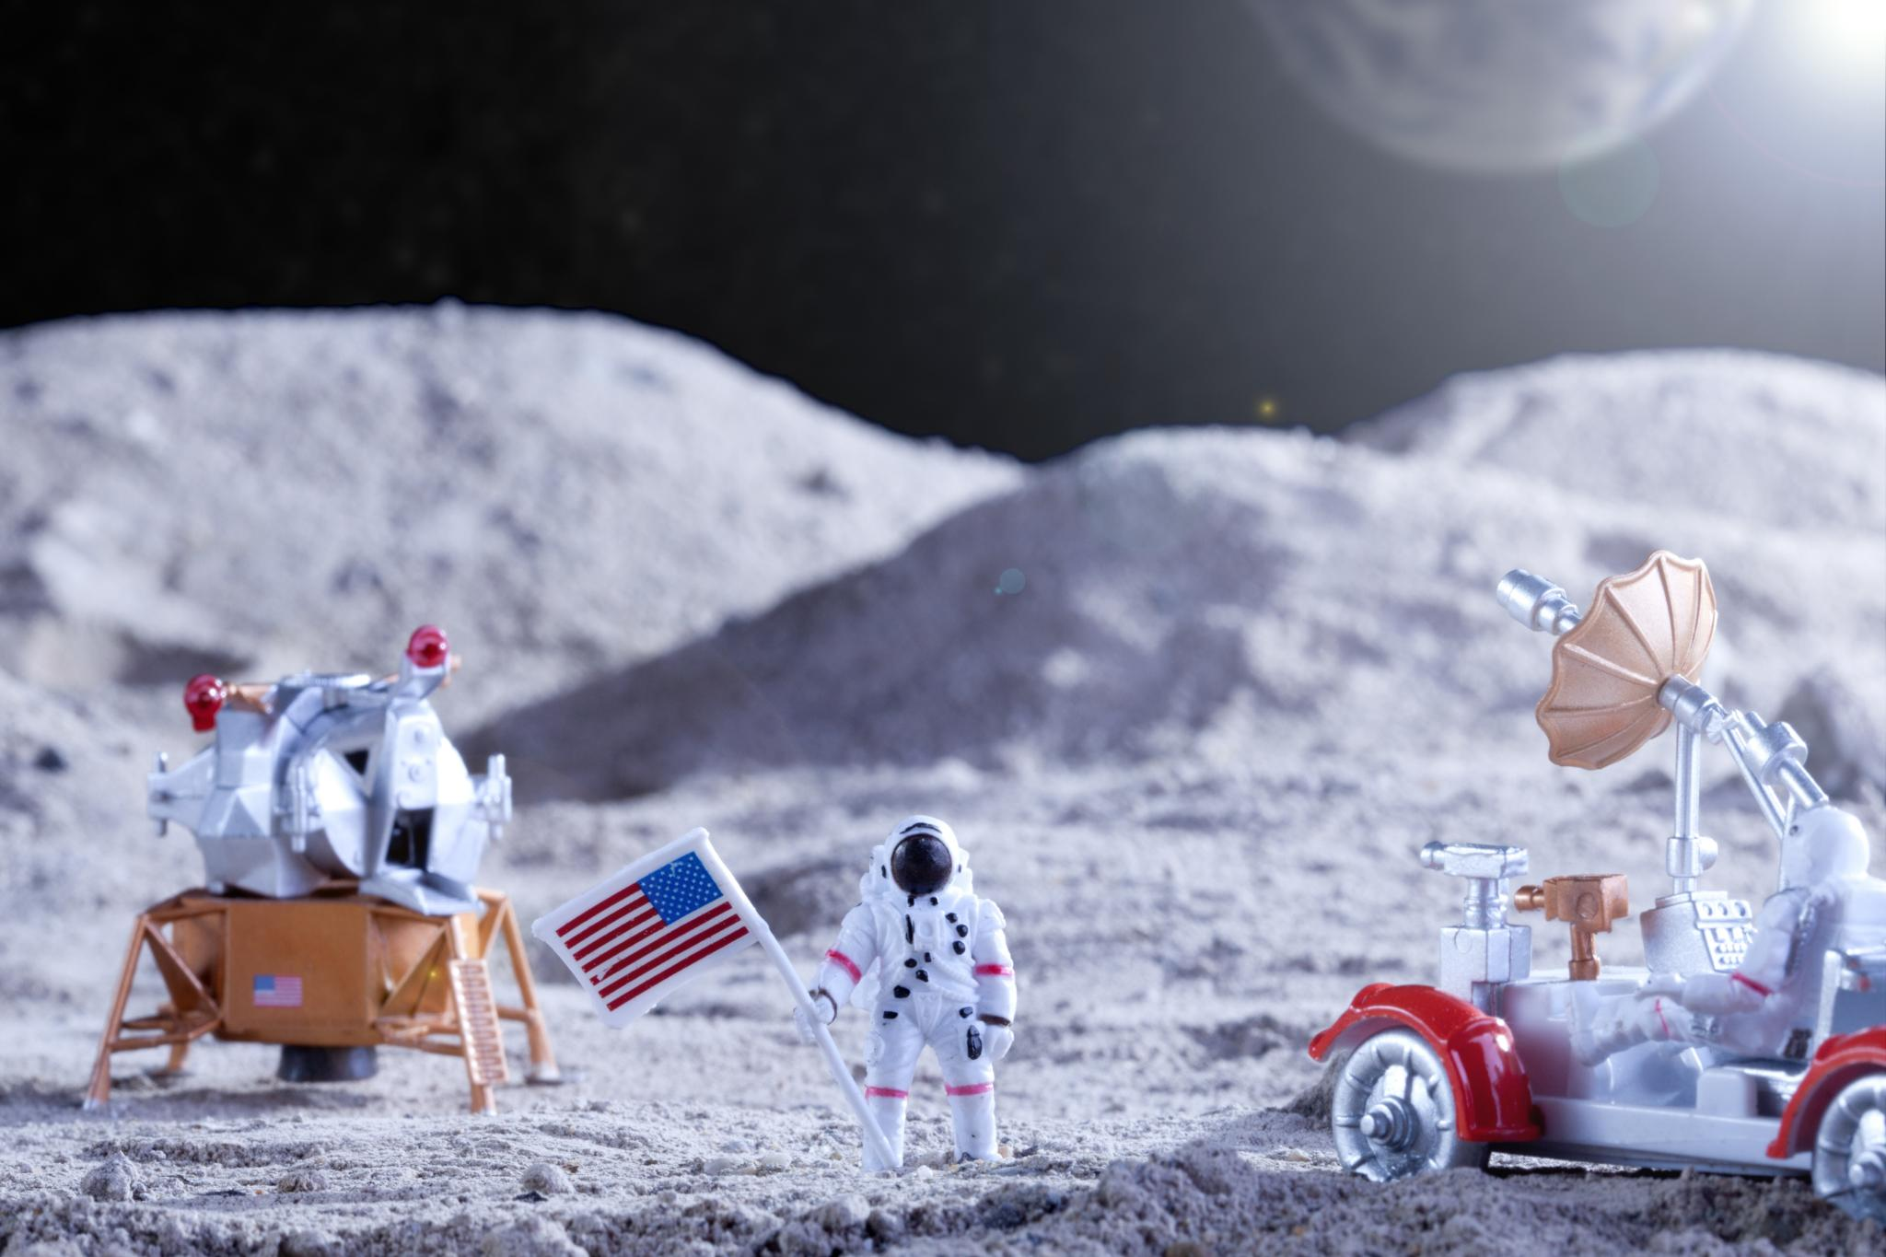
Goals and Significance
Inclusive Lunar Exploration
  Artemis aims to land the first woman and person of color on the Moon, promoting diversity and progress.
Scientific and Technological Advances
  The program focuses on lunar geology, water ice research, and sustainable technologies for deep space missions.
International Collaboration
  Artemis fosters global partnerships and commercial collaborations to drive innovation in space exploration.
Economic and Educational Impact
  Investing in Artemis fuels economic growth, inspires STEM education, and strengthens global leadership.

Slide 5
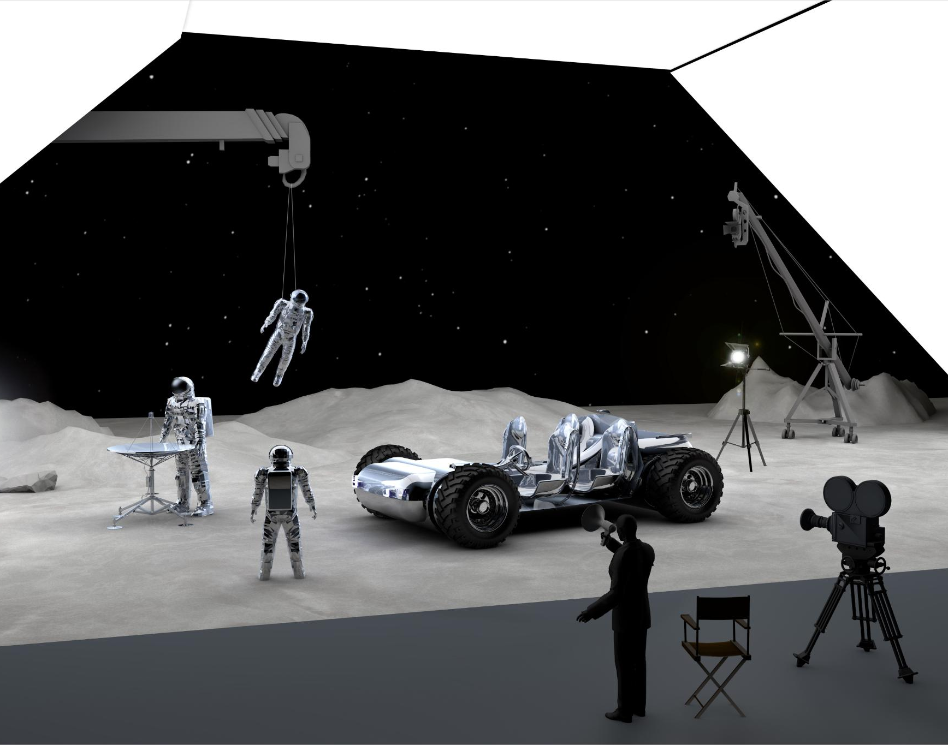
Economic and Workforce Impact
Lunar Economy Growth
  Artemis missions enable a lunar economy, stimulating industries in space technology and resource extraction.
High-Tech Job Creation
  These initiatives generate high-tech jobs that foster innovation and strengthen the global space sector.
STEM Education Impact
  Educational programs linked to Artemis inspire students to pursue STEM careers, building future talent pipelines.
Public-Private Partnerships
  Artemis encourages commercial investment through partnerships, creating a dynamic space-terrestrial ecosystem.

Slide 6

Human Exploration Vision
Inspirational Lunar Mission
  The Artemis program aims to inspire global audiences by returning humans to the Moon through innovation and collaboration.
Diversity and Global Partnerships
  Artemis emphasizes diversity, inclusion, and international partnerships to shape the future of space exploration.
Advanced Space Technologies
  The program features cutting-edge technologies like advanced propulsion, autonomous robotics, and sustainable habitats.
Uniting Humanity’s Vision
  Artemis seeks to unite humanity with a shared goal of exploring new frontiers beyond Earth.

Slide 7
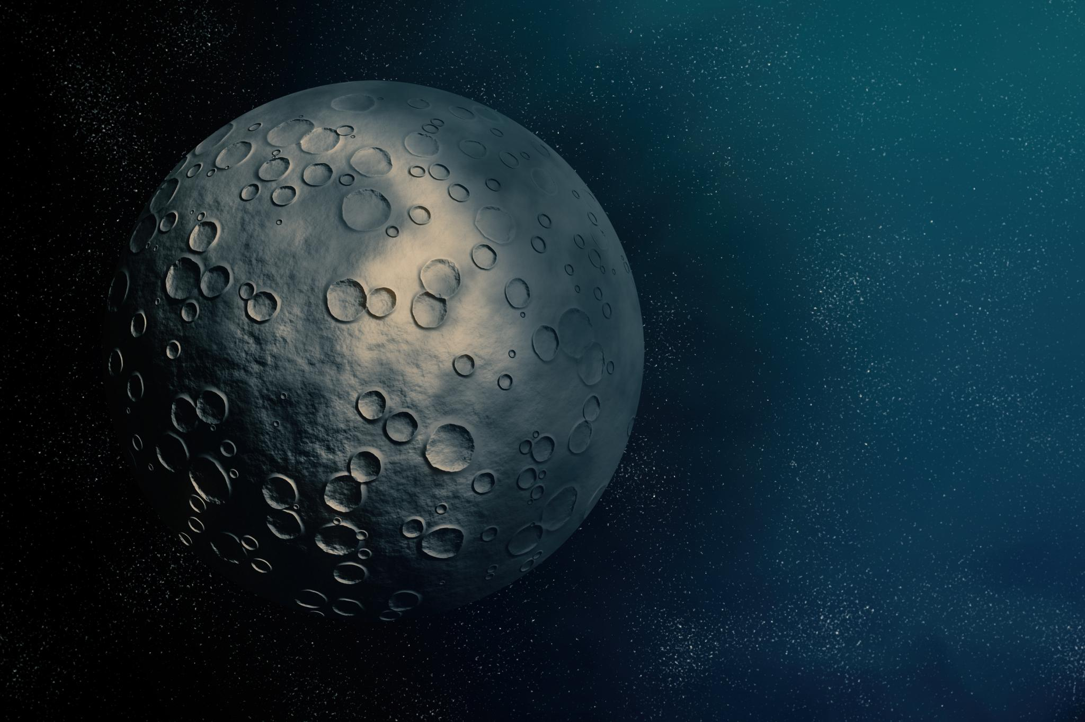
Mission Achievements
Powerful Rocket Launch
  Artemis I launched the most powerful rocket in the world, marking a major milestone in space exploration.
Distant Retrograde Orbit
  Orion spacecraft was placed in a distant retrograde orbit, farther than any human-rated spacecraft before.
Moon-Earth Transit Images
  The mission captured stunning images of the Moon transiting in front of Earth, showcasing celestial beauty.
Safe Ocean Recovery
  Orion safely landed in the Pacific Ocean, demonstrating effective heatshield and parachute systems.

Slide 8
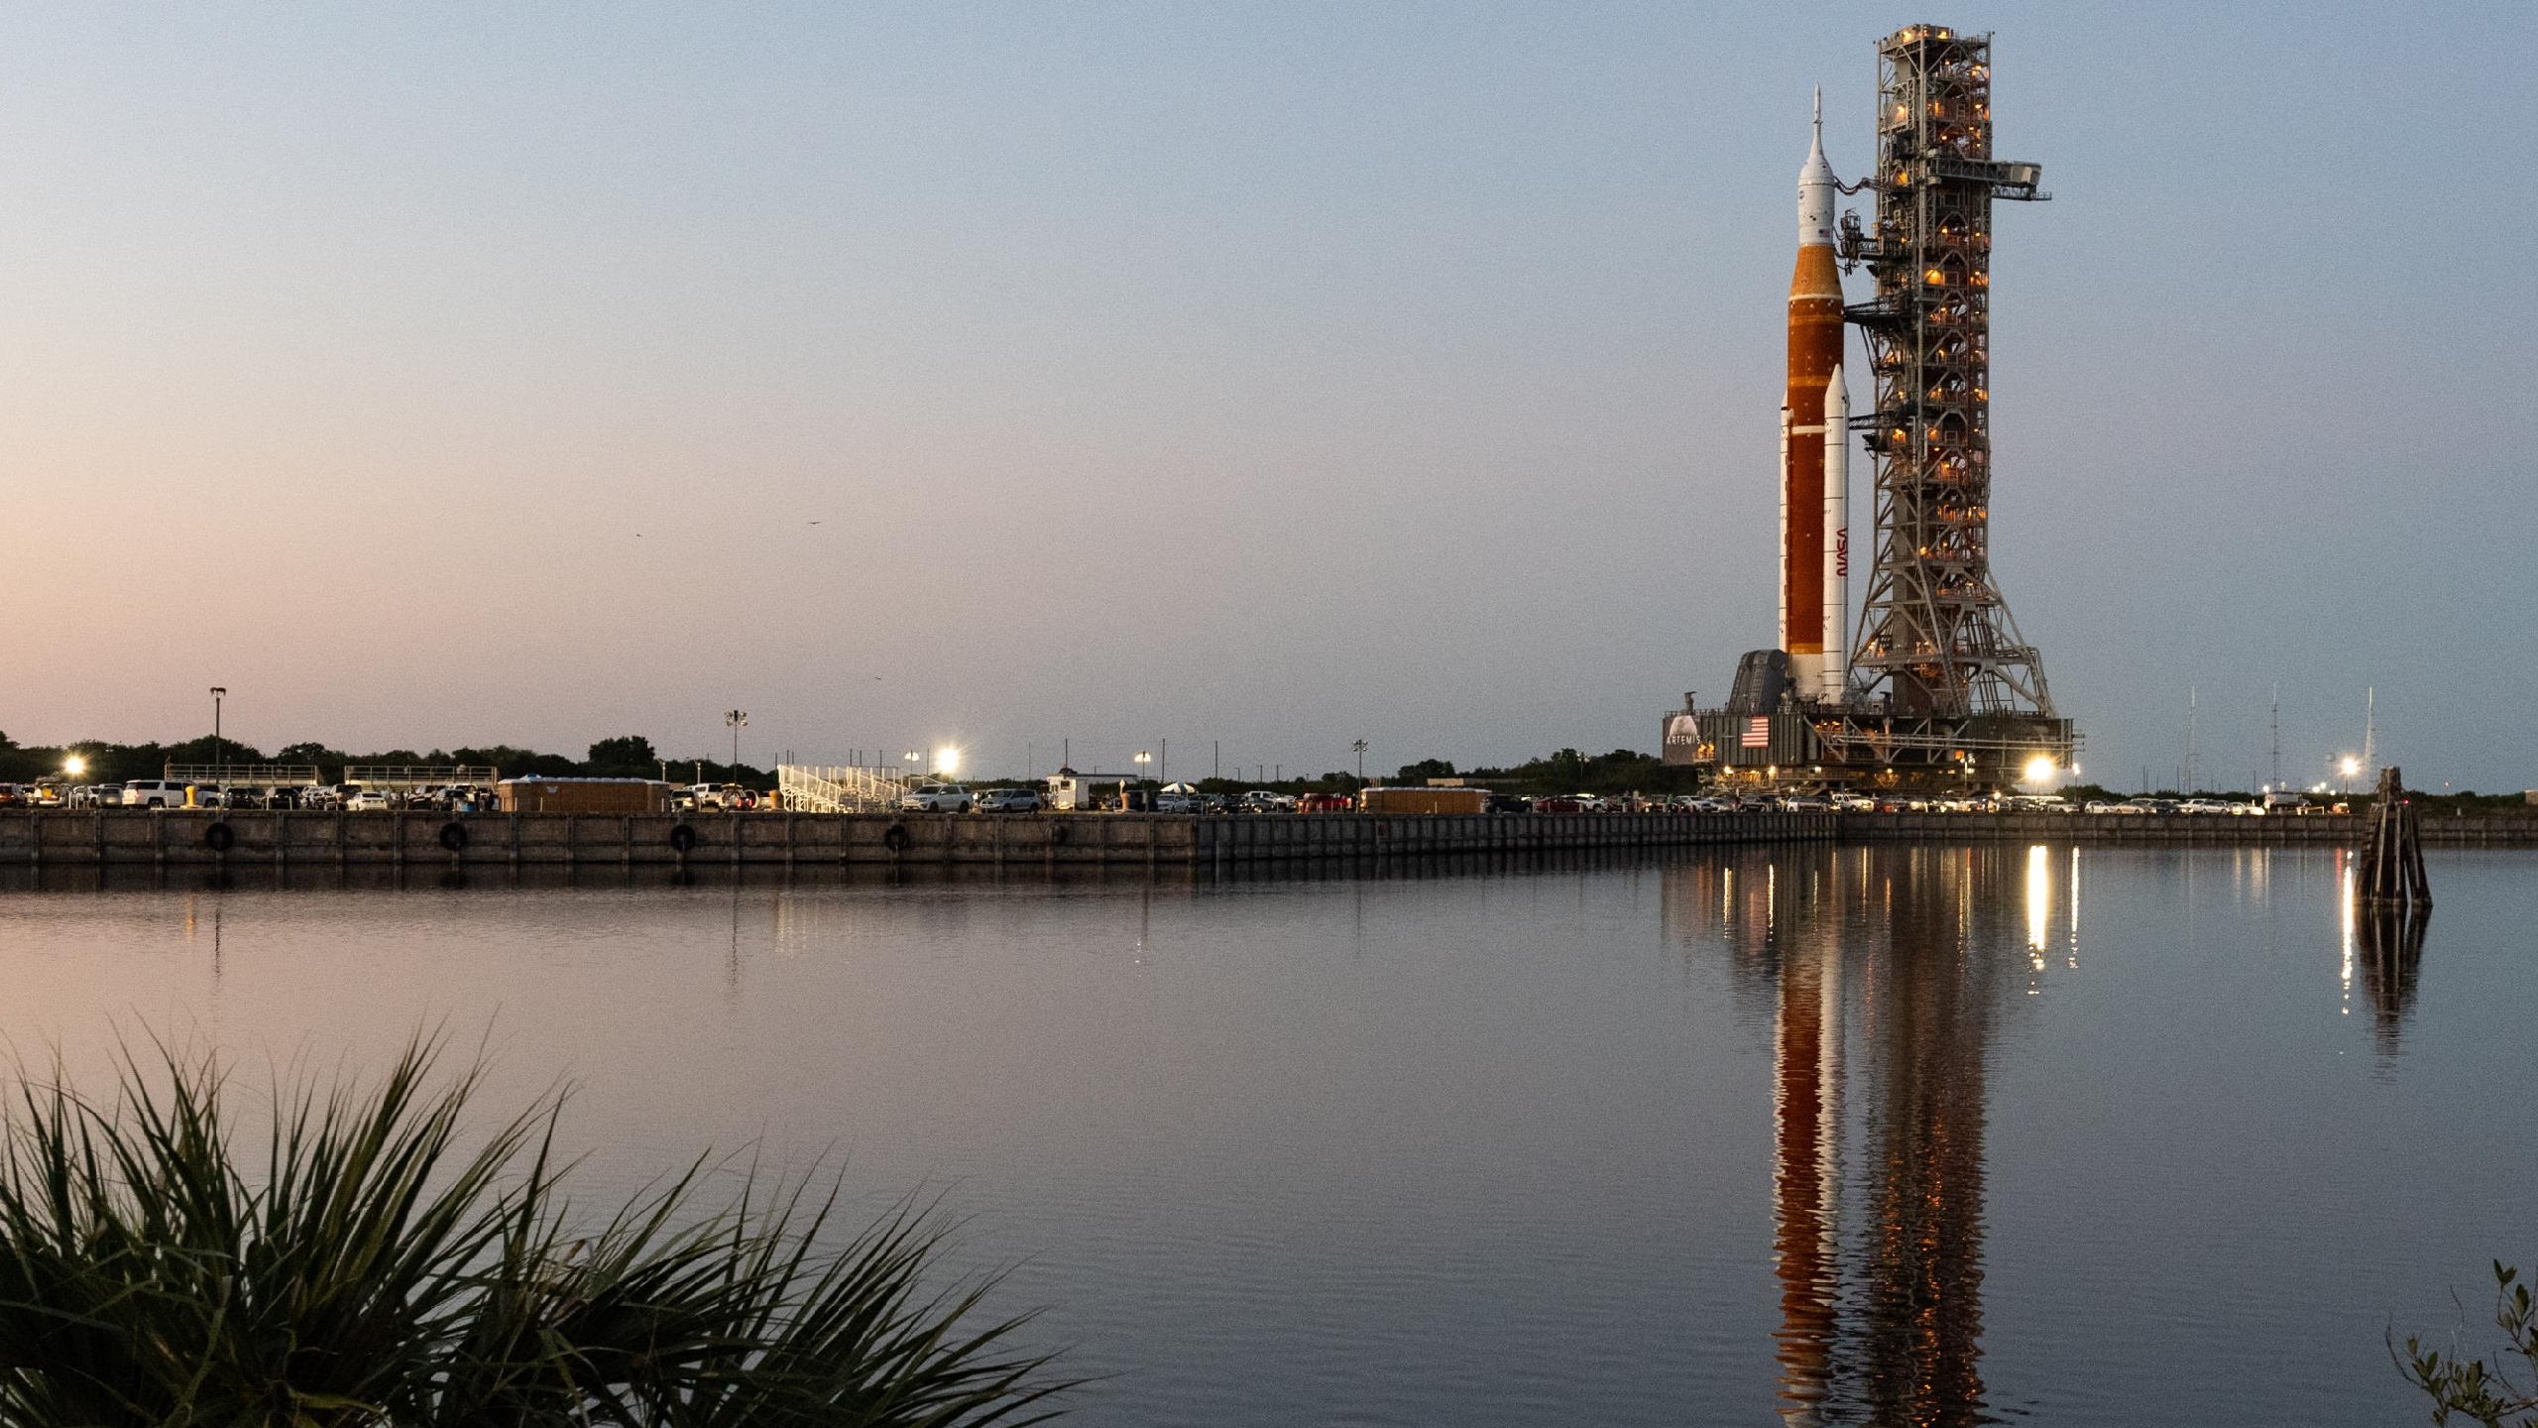
Thanks

